Slide 1


Slide 2
APPLICATION DEVELOPMENT
DIABETES PREDICTION USING MACHINE LEARNING

Slide 3
MEET OUR TEAM MEMBERS
S. Lavan karthik (2011CS010266)
M.Vamshi Reddy (2011CS010265)
P. Jayanth (2011CS010216)
S.Hari Sai Ram (2011CS010264)
UNDER GUIDENCE OF : Mr.M.Gouthamm,
Assistant Professor
Dept. of CSE.

Slide 4

INTRODUCTION
First before we learn about diabetes predictor , let us clearly know what diabetes actually is, Diabetes, also known as diabetes mellitus, is a group of metabolic disorders characterized by a high blood sugar level ( hyper glycemia ) over a prolonged period of time. Symptoms often include frequent urination, increased thirst and increased appetite If left untreated, diabetes can cause many health complications .Acute complications can include diabetic ketoacidosis, hyperosmolar hyper glycemic state, or death. Serious long-term complications include cardiovascular disease, stroke, chronic kidney disease, foot ulcers, damage to the nerves, damage to the eyes, and cognitive impairment.

Slide 5
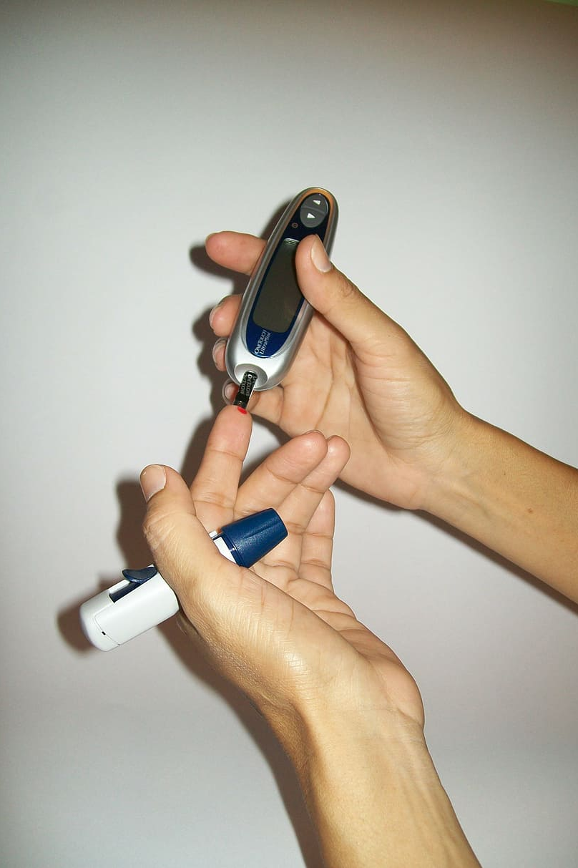
INTRODUCTION
Diabetes is due to either the pancreas not producing enough insulin, or the cells of the body not responding properly to the insulin produced. Insulin is a hormone which is responsible for helping glucose from food get into cells to be used for energy.
Symptoms of Diabetes
• Frequent Urination
• Increased thirst
• Tired/Sleepiness
• Weight loss
• Blurred vision
• Mood swings
• Confusion and difficulty concentrating
• frequent infections

Slide 6
EXISTING SYSTEM:
Existing many research handled for the diabetes detection. Data mining approach like clustering, classification were studied in existing system. Diabetes prediction using algorithm such as K-NN,K-Means, branch and bound algorithm was proposed. A basic diabetic dataset is chosen for carrying out the comparative analysis. The importance of feature analysis for predicting diabetes by employing machine learning technique is discussed.

Slide 7
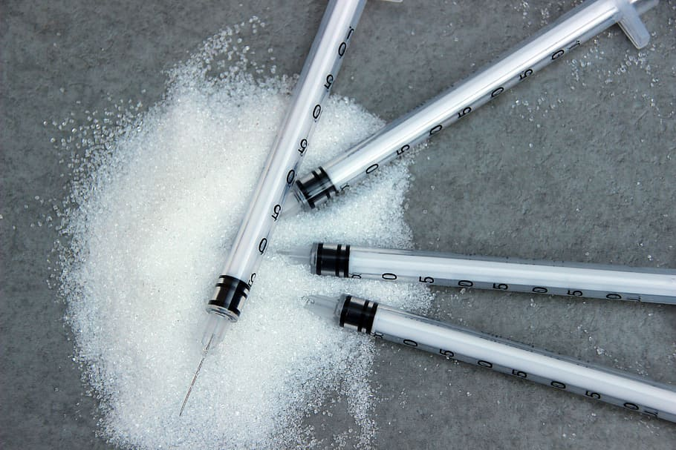
LIMITATIONS OF EXISTING SYSTEM:
High false positives. There is no interactive tool for users to predict diabetes.
Costing: The Existing system is high cost and this is main reason most of the system is failed.
Technology Complexity: Most of system is complex to understand, Not user friendly as compare to our proposed system .
Time Consuming Feature: In existing system, the performance is low and most of the time system gets hanged due to load.
Not Easy to Understand: Systems re complex to understand and they were not user friendly.

Slide 8
PROPOSED SYSTEM
The Proposed System study is classification of Indian kaggle dataset for diabetes as a binary classification problem.
This is proposed to achieve through machine learning classification algorithms and Regression.
For machine learning, SVM algorithm, K-NN algorithm, Random Forest algorithm and Logistic Regression are proposed.
The proposed system improves accuracy of prediction through Random Forest Classification.
The proposed also has the frontend with the angular code.
The website is fully dynamic and a user friendly website.
Then the project has deployed in the AWS ec2 backend is deployed and the front is deploy in the s3 bucket.

Slide 9
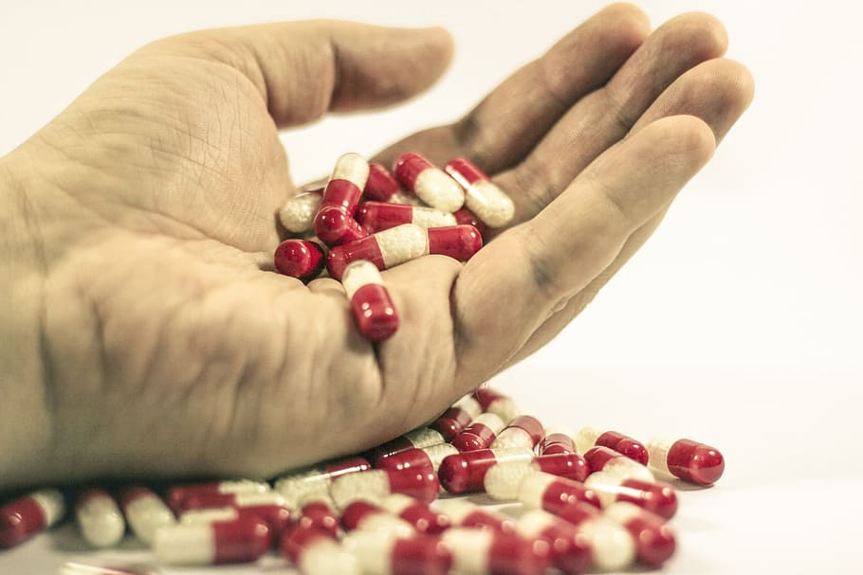
BENEFITS OF THE PROPOSED SYSTEM
Interactive application, in which user can give a single input to arrive the prediction.
Accuracy is improved using machine learning techniques.
By this project we can know about the machine learning algorithms and AWS basics.
The client can easily find the disease of the diabetes that the person is having or not.
User friendly website that can easily understand by any one and can easily give as accurate outcome.

Slide 10
ARCHITECTURE OF PROPOSED SYSTEM
START
RANDOM FOREST CLASSIFICATION
DIABETES DATASET
EDA
TRAIN AND TEST DATA
OUTCOME
LOAD PICKLE FILE
BROWSE THE STATIC WEBSITE
DEPLOY ANGULAR FRONTEND IN S3 BUCKET
CONNECT TO FRONTEND USING EC2 IP ADDRESS .
DEPLOY IN AWS EC2
FASTAPI

Slide 11
SYSTEM REQUIREMENTS
SOFTWARE REQUIREMENTS
➢ Python(backend)
➢ FastAPI(framework)
➢ Angular(frontend)
HARDWARE REQUIREMENTS
➢ Processor: minimum 1 GHz or more.
➢ Ethernet connection (LAN) OR a wireless adapter (Wi-Fi).
➢ Hard drive: Minimum 32 GB ; Recommended 64 GB.
➢ Memory (RAM): Minimum 1 GB; Recommended 4 GB.

Slide 12
ALGORITHM
STEP1: Gathering the data from the kaggle and understand about the dataset and preparing the data by removing the missing values.
STEP 2: Now we split the gathered data into training and testing dataset.
STEP 3: Now using training data we create a Random Forest Classification model.
STEP 4: Using the testing data we test the created Random Forest Classification model and import the pickle file.
STEP 5: Using the model now we predict diabetes.

Slide 13





pickle
deploy
Connect ip
deploy

Slide 14
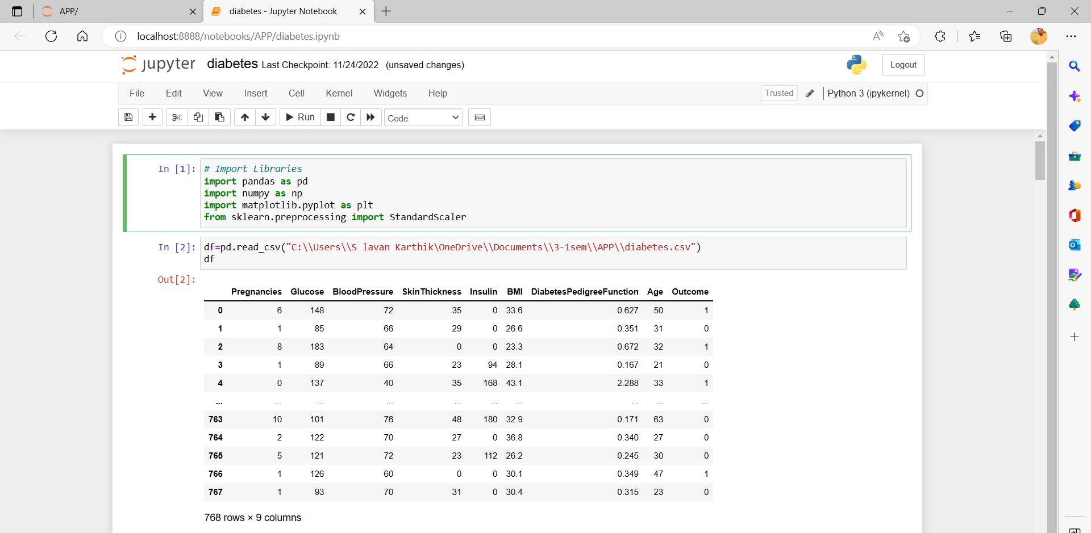
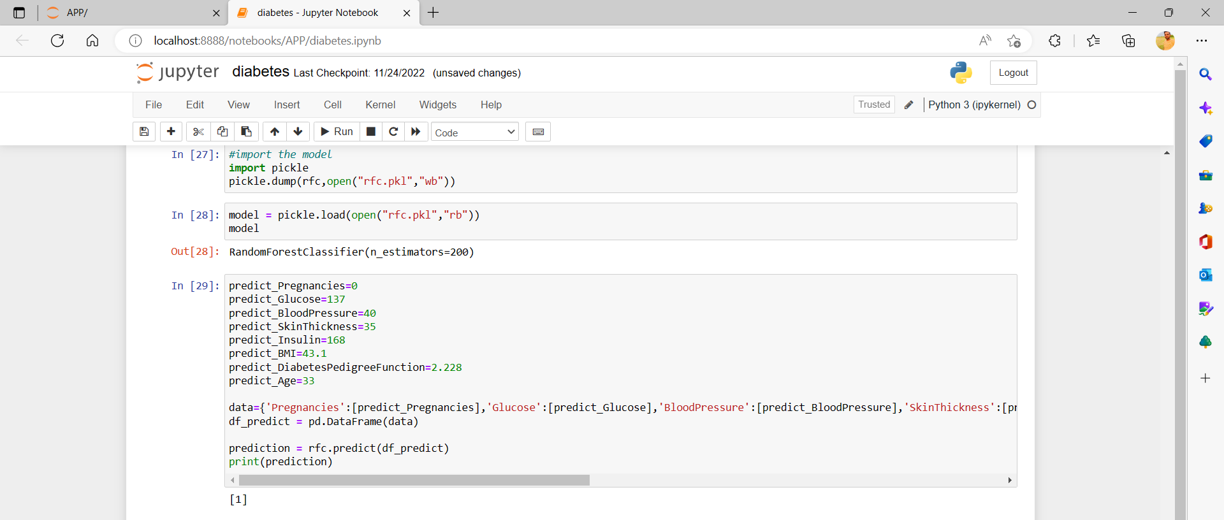
JUPYTER CODE

Slide 15
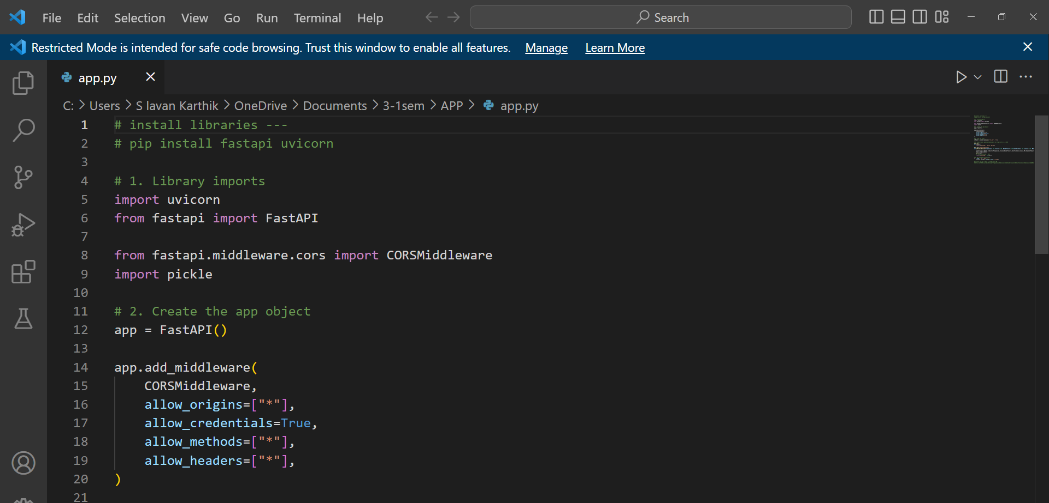
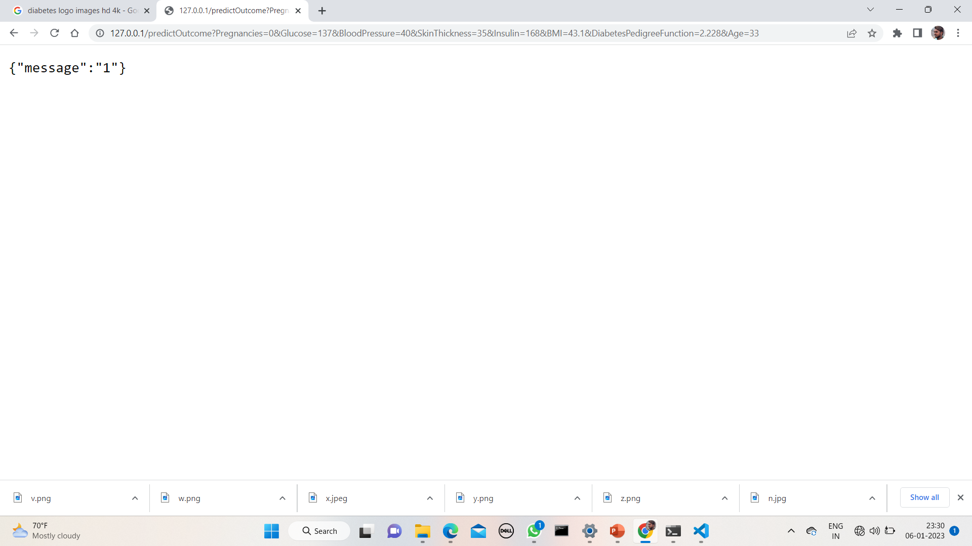
FAST API CODE

Slide 16
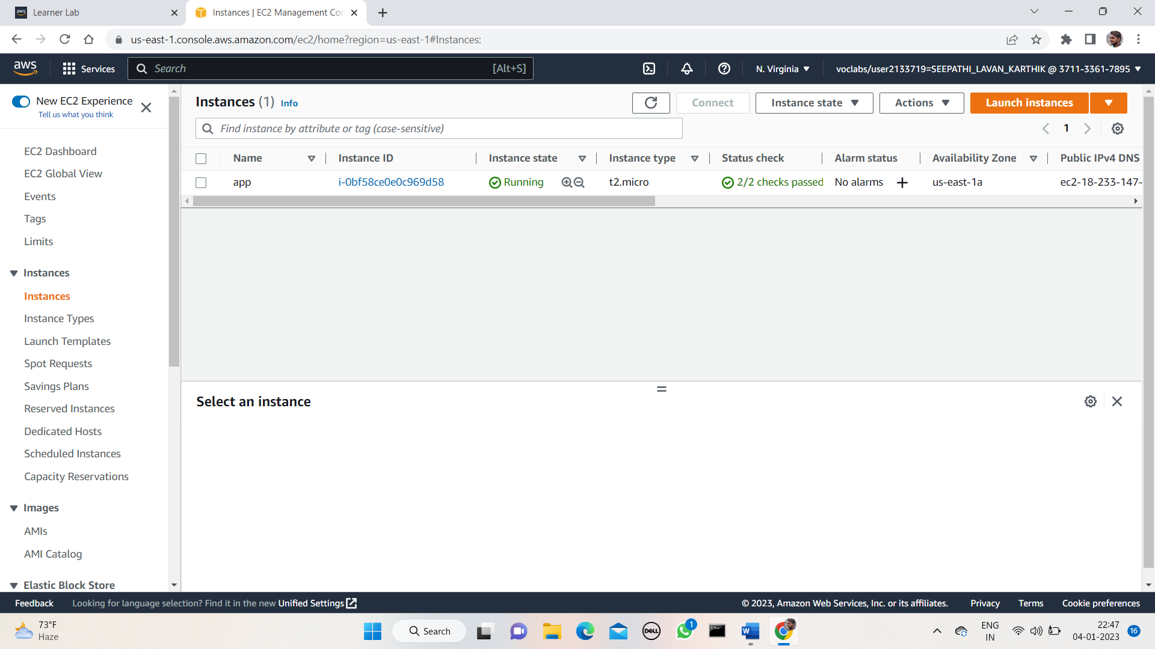
AWS EC2

Slide 17
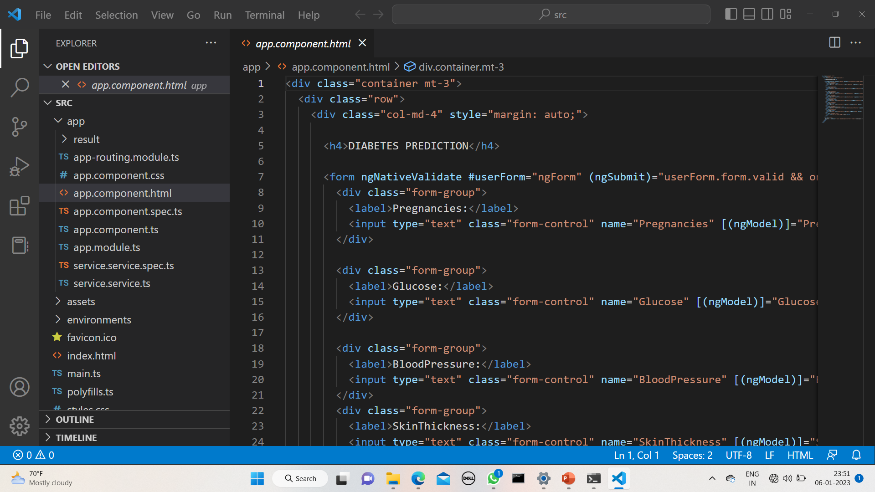
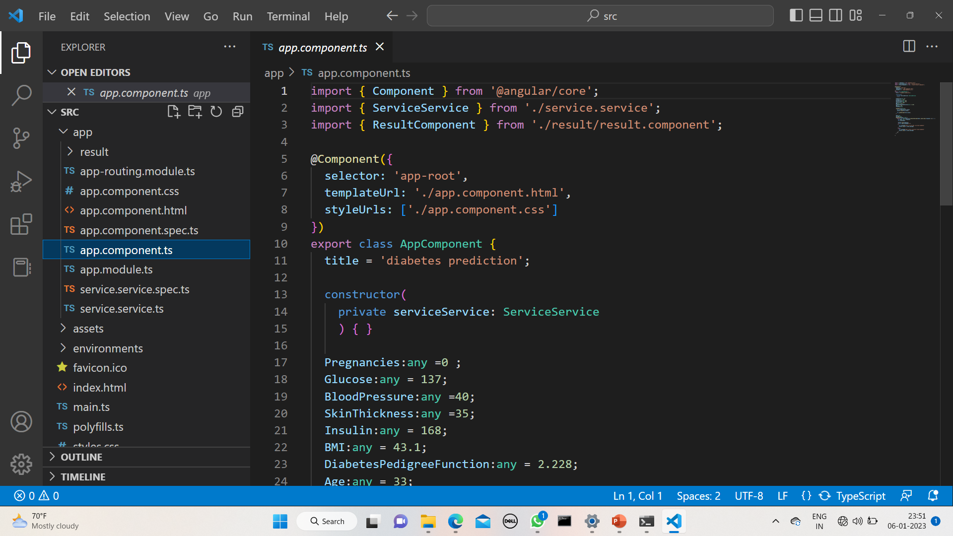
ANGULAR CODE
app.component.html
app.component.ts

Slide 18
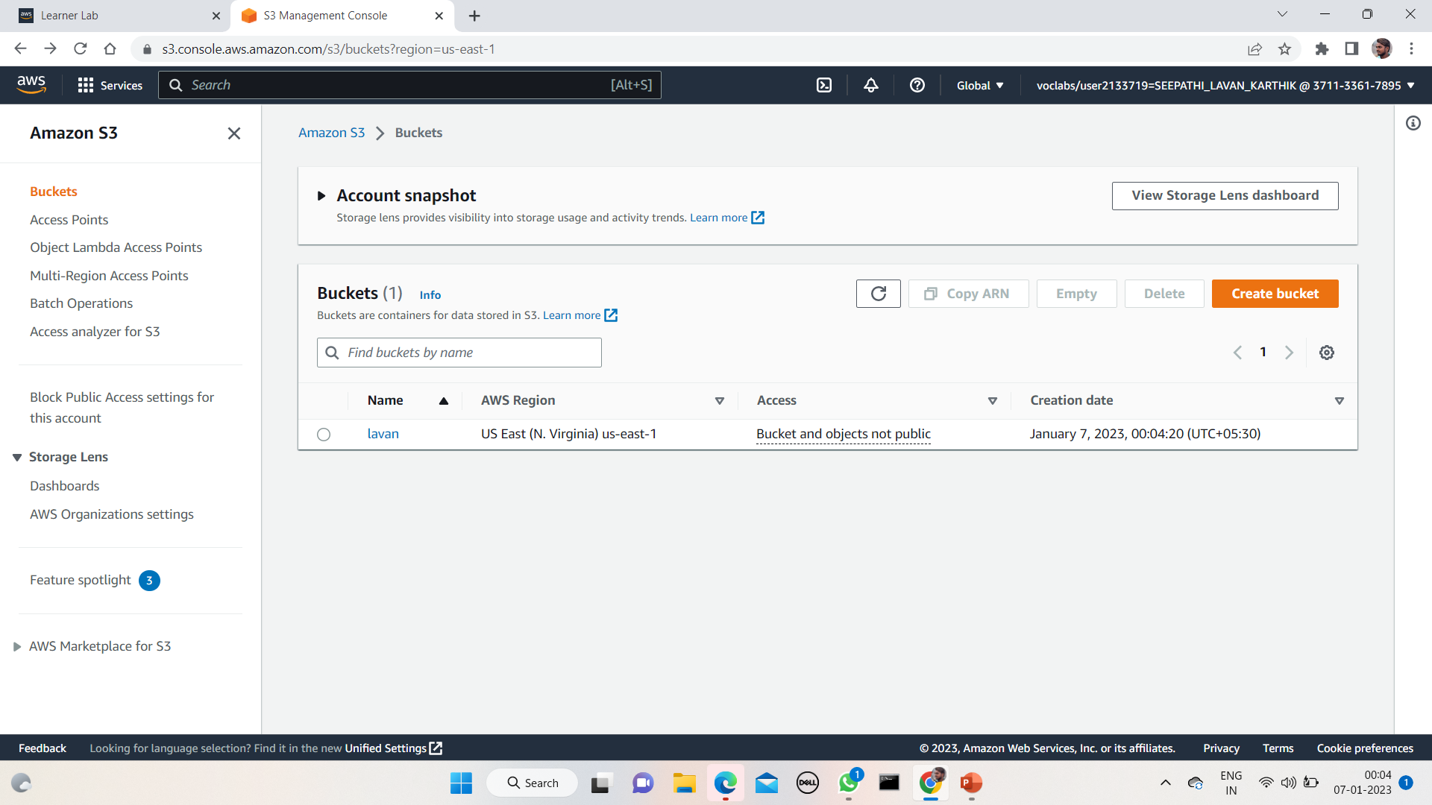
AWS AMAZON S3

Slide 19
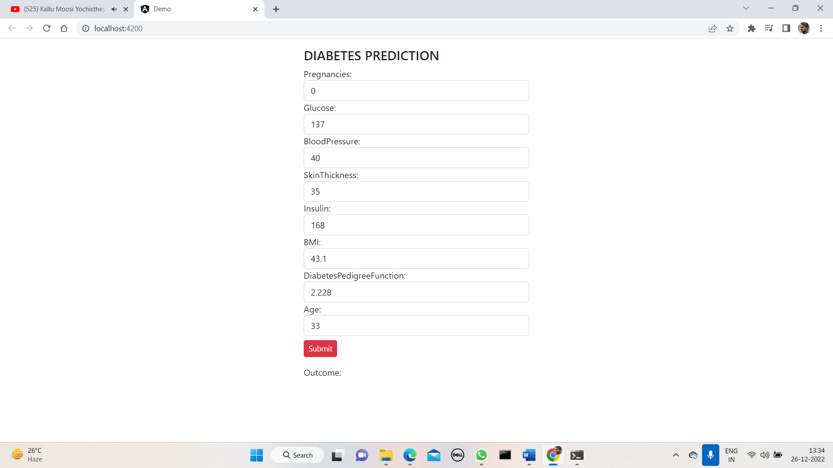
RESULT
URL OUTCOME

Slide 20
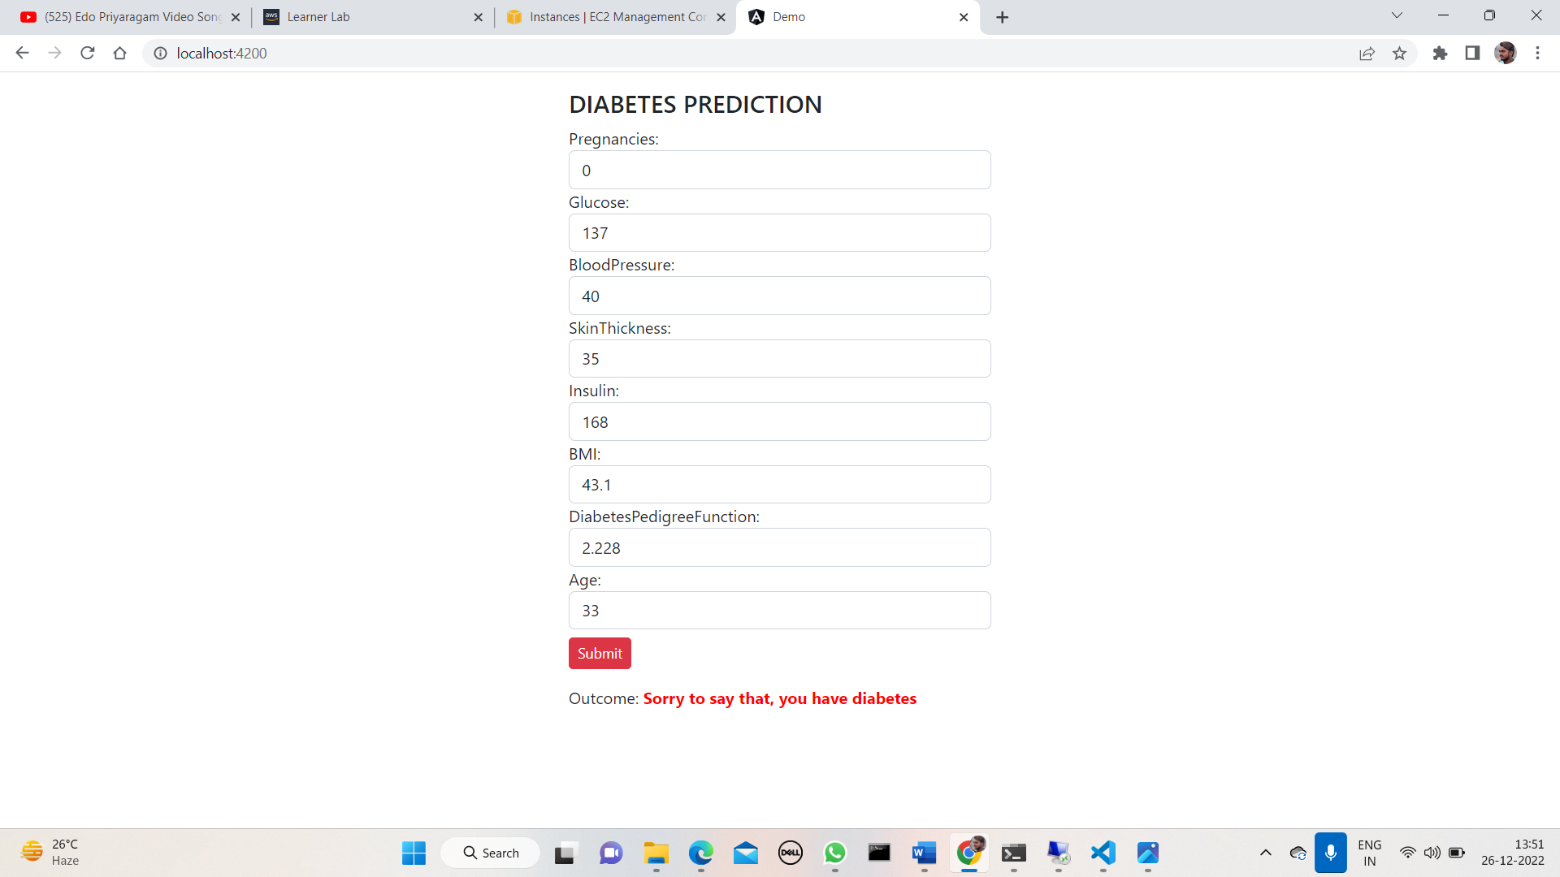
For the given values the patient has the diabetes

Slide 21
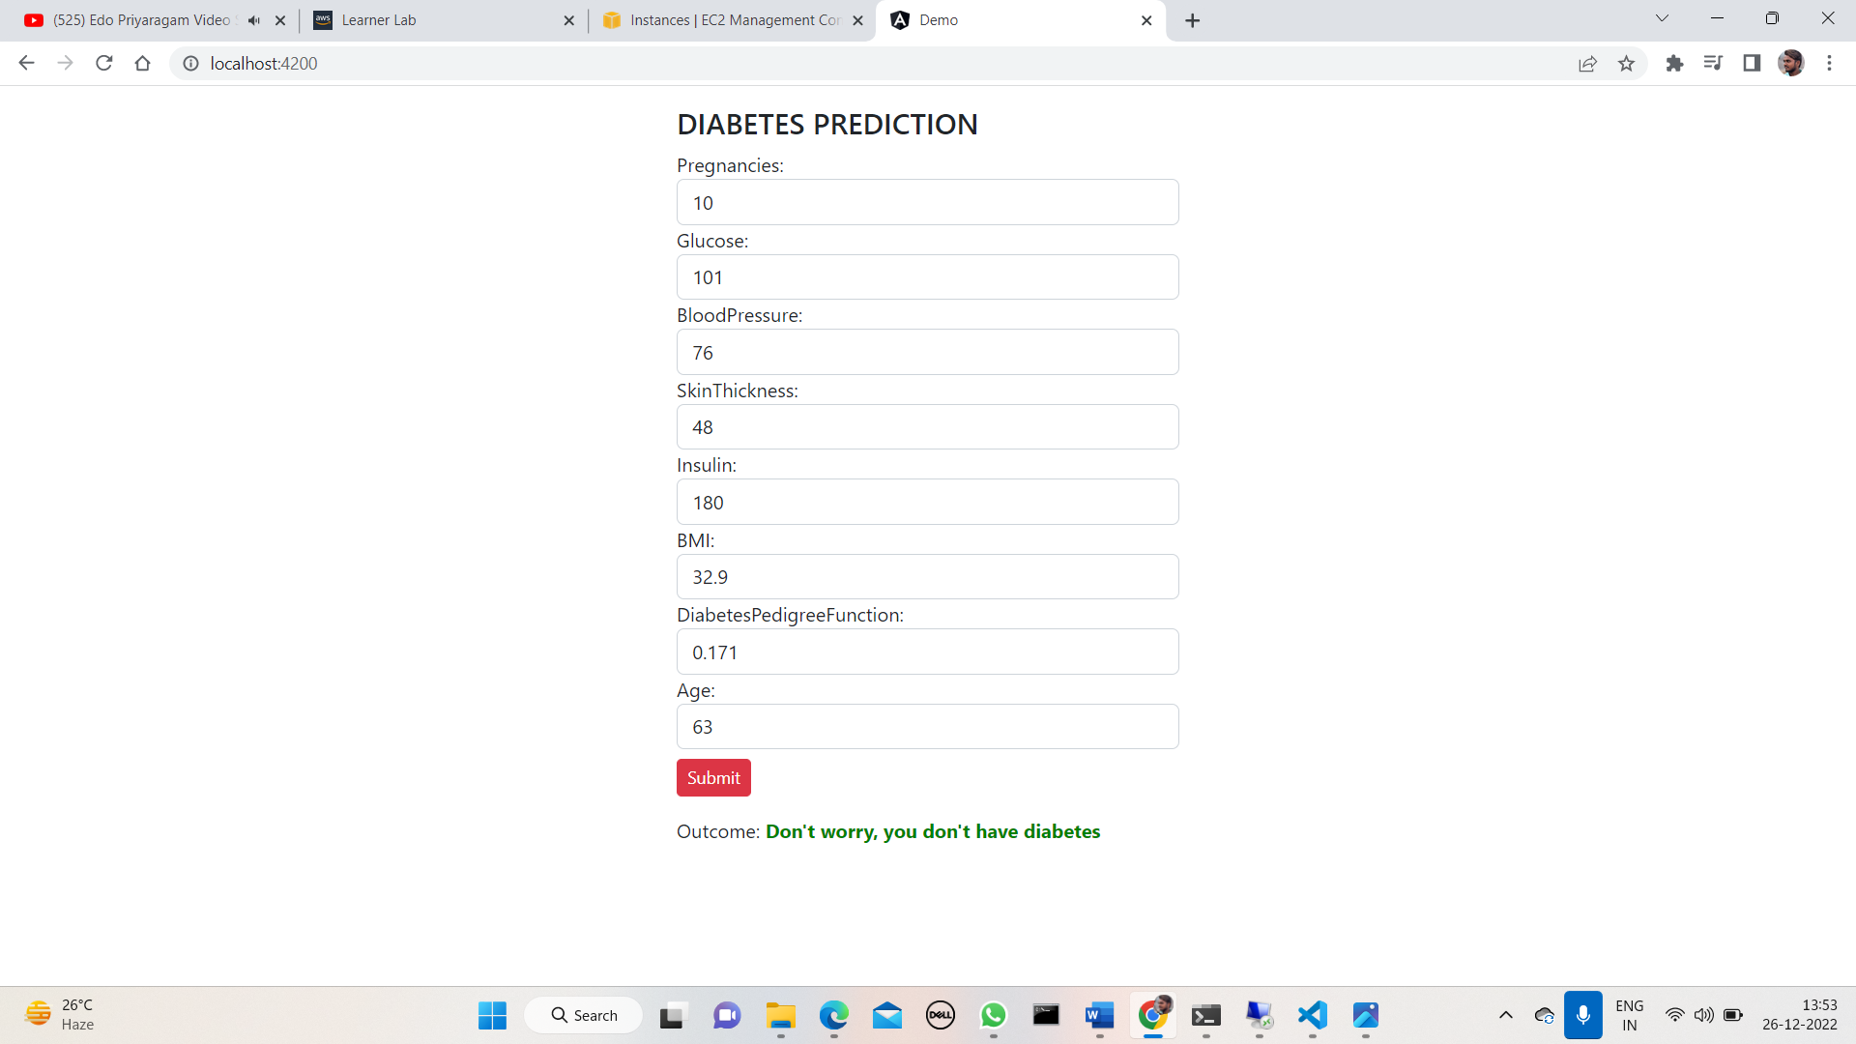
For the given values the patient don’t have the diabetes

Slide 22
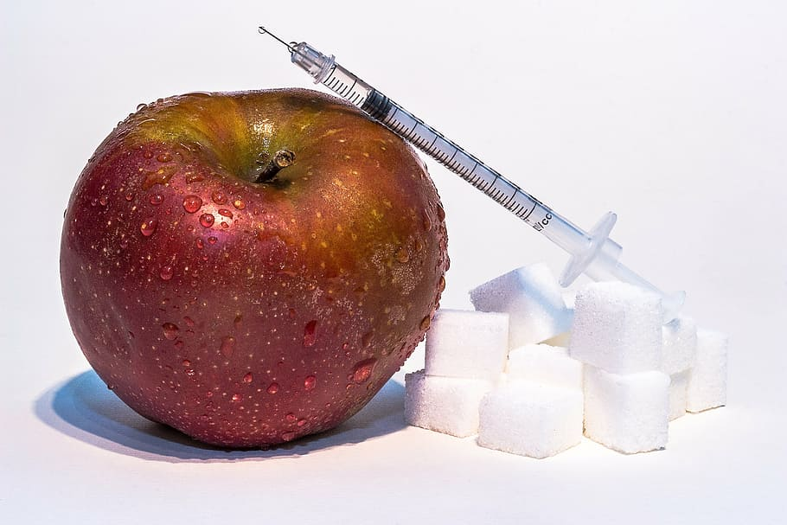
Thank you

